Slide 1
Mining Worker Safety Helmet
PRESENTED By :
Hariharan.A.S(22AIL01)
Pranesh.G(22AIL02)
Thanver.K.S(22AIL03)
Guided By :
DR.K.LALITHA
TEAM NO : 22
22AIP10 - INTERNET OF THINGS AND ITS APPLICATION LABORATORY

Slide 2
Abstract
The Mining Worker Safety Helmet is a critical personal protective equipment (PPE) designed to enhance safety in hazardous mining environments.
This helmet is engineered to provide robust protection against falling objects, impacts, and electrical hazards.
It incorporates advanced materials such as high-impact-resistant polymers and energy-absorbing liners to mitigate injury risks.
The design often includes features like integrated communication systems, adjustable chin straps, and ventilation to address various operational needs.

Slide 3
Objectives:
Real-Time Monitoring
Environmental Hazard Detection
Location Tracking
Emergency Alerts and Communication
Fatigue Detection
Helmet Impact Detection
Data Logging and Analysis
Battery Management
Integration with Mine Safety Systems
User-Friendly Interface

Slide 4
Components Required:
Arduino (NodeMCU ESP8266)
Pressure sensor
Air quality sensor
LCD display
Humidity sensor
Buzzer(Alert system)
IR sensor

Slide 5
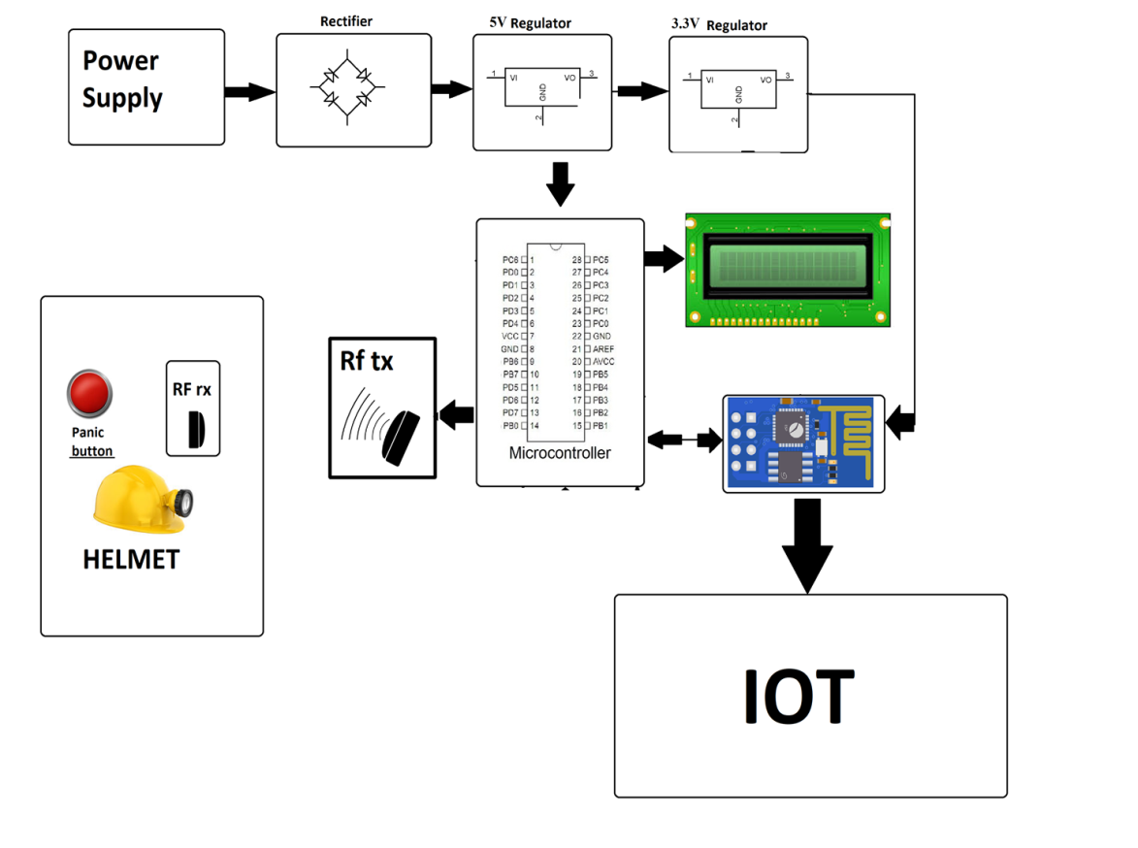
Flow Diagram:

Slide 6
Implementation: (Hardware or software)
Step 1 : Component Selection
Step 2: Circuit Design & Prototyping
Step 3: Software Development
Step 4: Integration & Testing
Step 5: Power Management

Slide 7
Implementation: (Hardware or software)
Step 1: Sensor Data Collection
Step 2: Data Processing
Step 3: Real-Time Alerts
Step 4: Wireless Communication
Step 5: GPS Tracking
Step 6: Data Logging & Monitoring

Slide 8
Thank u slide

